Slide 1


Slide 2
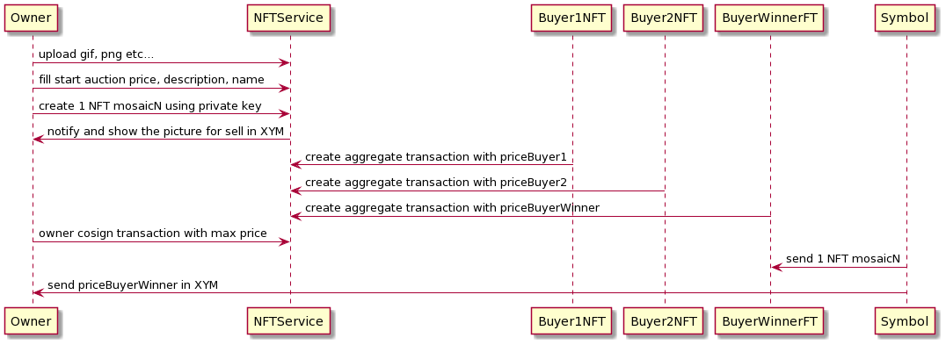
Business shema

Slide 3
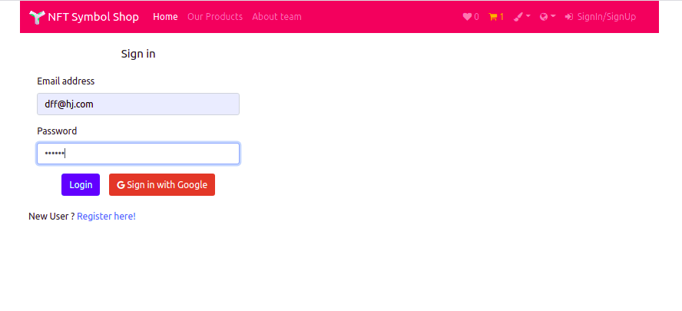
https://spreadzp.github.io/symbol-ecommerce/
Auth/Login

Slide 4
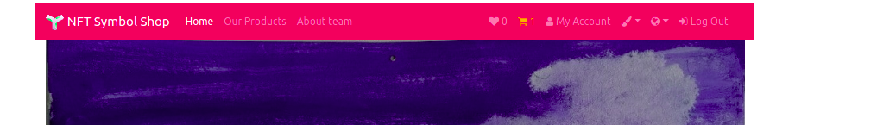
Head of the site
You can change language, color theme
Your bucket, cabinet and favorites NFT
Logut

Slide 5
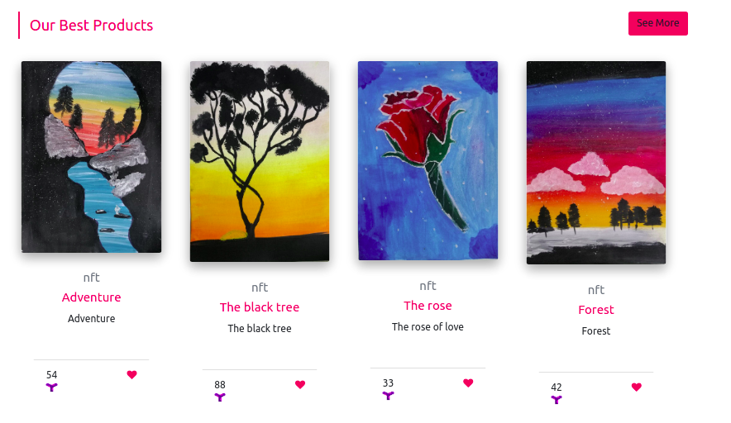
NFT slider

Slide 6
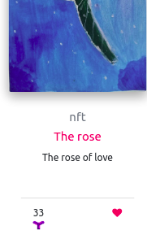
NFT card description, price, name, favorite button

Slide 7
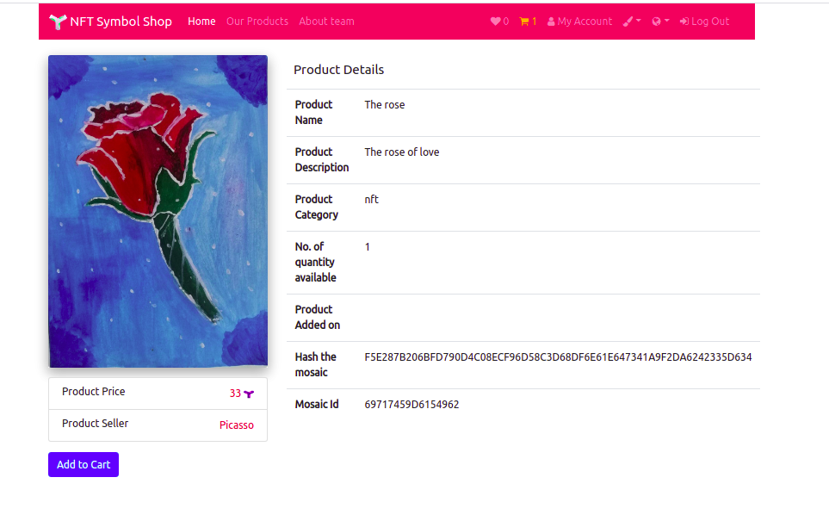
NFT card with info about NFT mosaic

Slide 8
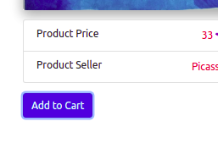

After push
we can redirect to bucket

Slide 9
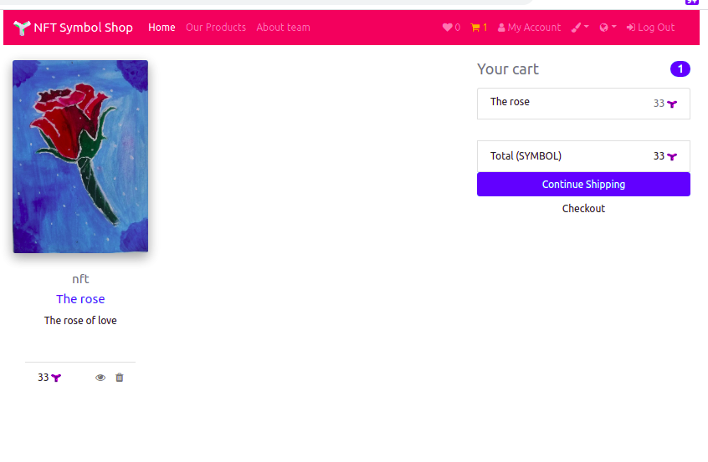
The bucket, push checkout for payment

Slide 10
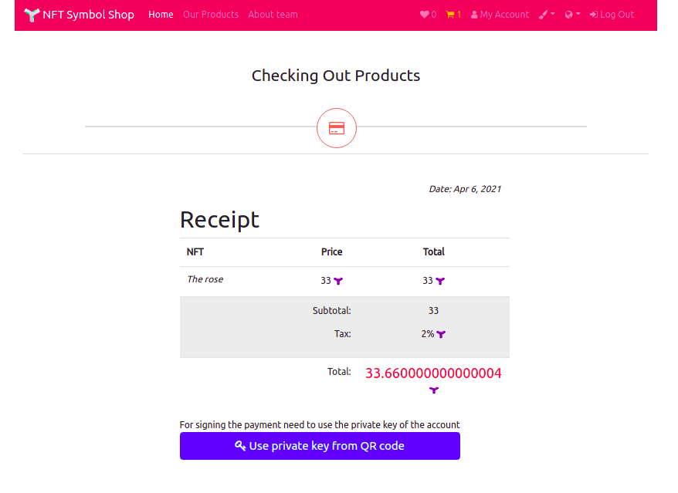
The application can add tax

Slide 11
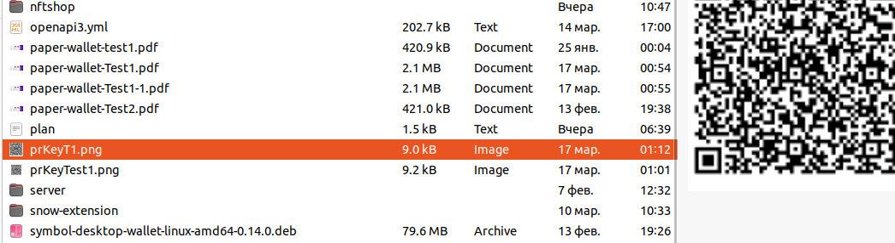
For sign the payment using qr code with private key. The key not save in browser or application. Every time need to use the file

Slide 12
Contact info
Team "Caravan"
https://spreadzp.github.io/symbol-ecommerce/about
spread2009@gmail.com
https://t.me/Spread2018
Best regards,
Paul Karpus
full-stack blockchain developer

